Slide 1
Practice #4
Create Performance Task

Slide 2
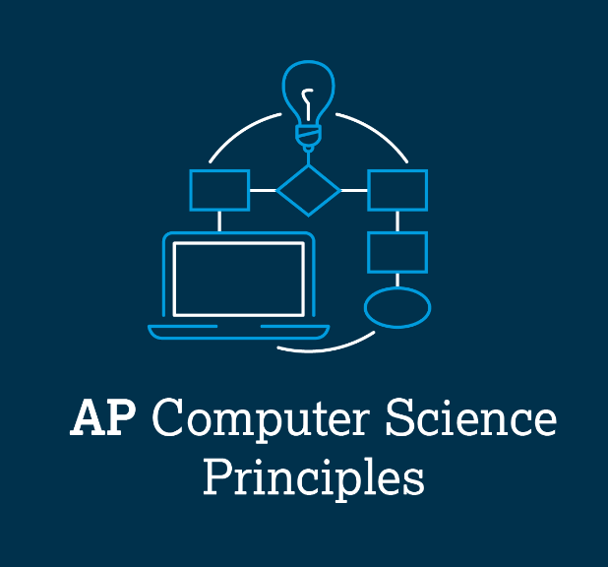
AP CSP Create Performance Task
Part of the AP Exam is to create a program that meets specific requirements:
Creates a list
Uses a list in a meaningful way
Has a function with a parameter
  Parameter affects function execution
Function has:
  If statement
  Loop

Slide 3
AP CSP Create Performance Task
The Create PT is like a remix project:
Start small and add components.
Start with what you know.
Don’t try something new that you don’t know how to do.
This isn’t a time to learn something new, but to show what you know how to do.

Slide 4
AP CSP Create Performance Task
The Create PT is like a remix project:
For this lesson, let’s look at another program from a mission that may work for the Create PT project: LineFollow1
Open the program and review what it does and how it does it.

Slide 5
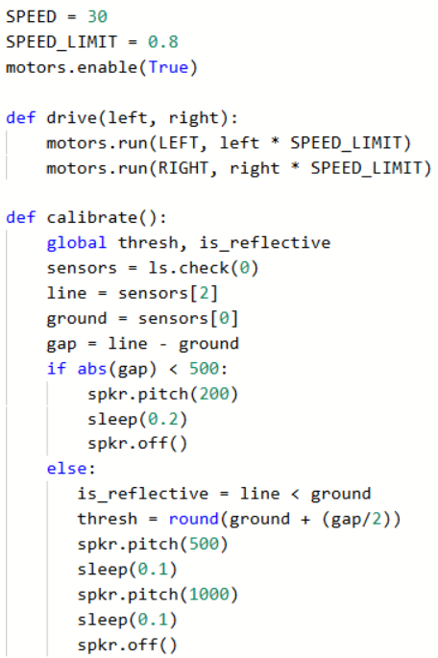
AP CSP Create Performance Task
In CodeSpace, go to the Sandbox.
Open the project: LineFollow1
Go to File Save As… and rename the file PT_CodeBot_Practice4
What PT requirements does it meet?
What PT requirements does it lack?

Slide 6


Practice #4
Check the PT Requirements:
Creates a list
Uses a list in a meaningful way
Has a function with a parameter
  Parameter affects function execution
Function has:
  If statement
  Loop

Slide 7
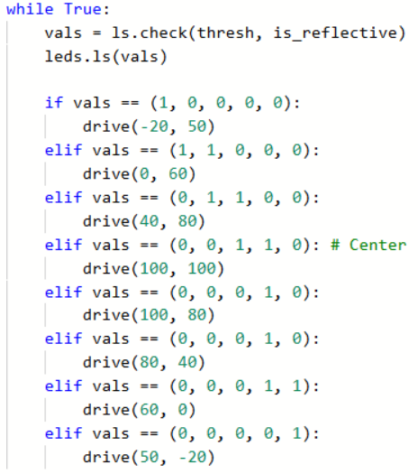
Practice #4
At first glance, this project barely meets a couple requirements.
Let’s look more closely at the code and the requirement for a list.

Slide 8
Practice #4
Check the PT Requirements:
Creates a list
Uses a list in a meaningful way
Has a function with a parameter
  Parameter affects function execution
Function has:
  If statement
  Loop

Slide 9
Practice #4
The line:
creates a tuple – vals.
A tuple is a list that you can’t change, meaning you can’t append or remove items.
But it is still a list! And it is definitely being used.

Slide 10
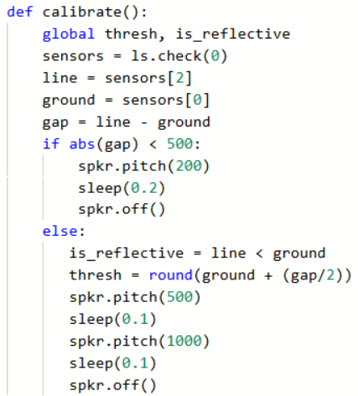
Practice #4
Look at the code for calibrate().
Is there code in the function that can be used as a parameter?

Slide 11
Practice #4
Look at the code for calibrate().
The variable gap is used in an if statement.
You can move code from the beginning of the function to before the function call, and use gap as a parameter.

Slide 12
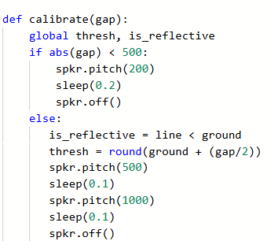
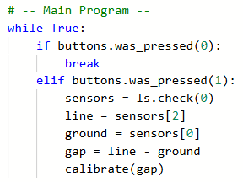
Practice #4
The modified code could look like this:

Slide 13
Practice #4
Check the PT Requirements:
Creates a list
Uses a list in a meaningful way
Has a function with a parameter
  Parameter affects function execution
Function has:
  If statement
  Loop

Slide 14
Practice #4
Now all requirements but one are met.
Review the calibrate() function again.
Is there something you can add to the function that uses a loop?

Slide 15

Practice #4
The function uses one or two beeps to indicate if the ‘bot is calibrated.
You could change the single or double beep to repeat in a loop.
Or you can add flashing LEDs.
Add code that uses a loop to one or both if statement branches.
* You decide! This code is not provided for you.

Slide 16
Practice #4
Once you have added a loop to calibrate(), check the PT Requirements:
Creates a list (tuple)
Uses a list in a meaningful way
Has a function with a parameter
  Parameter affects function execution
Function has:
  If statement
  Loop

Slide 17
Practice #4
Now that you have seen an example a remix from LineFollow1, can you think of any other ways to remix the program for the Create PT?
Go to the Activity Guide and write down any more ideas you have for modifications.

Slide 18
Practice #4
Final considerations.
Your program needs to have input and output.
  Be prepared to explain the input and output of this program.
  This program has input through button presses.
  In a video, you want to show the button presses, or add a caption that explains how the video shows input
  The output is the ‘bot moving, the LEDs and the speaker beeps
  In a video, you want to show at least some, if not all, of the output.

Slide 19
Practice #4
Final considerations.
Your program needs to have a specific purpose and intended user.
Here is an example of how you might explain the purpose, function and intended user.
  The purpose of this program is to automate a task.
  The function of the program is for the ‘bot to follow a line unassisted.
  The intended user is someone in industry who needs to automate a task.

Slide 20
Practice #4
Final considerations.
You need to explain how the list manages complexity.
How would the code be written differently?
Here is an example of an answer:
  The built-in function ls.check() reads all five line sensors at the same time and returns a tuple of the readings. A tuple is a type of list. I could check each line sensor separately, and use a variable for each line sensor reading. Then instead of comparing all the sensors at the same time with if val == (1, 0, 0, 0, 0) for each scenario, I would have to use an if statement with five conditions. I would have to do this for each scenario.

